Slide 1
EKS 환경에서 MySQLd Exporter를 활용한 Aurora MySQL 모니터링 구축
신 정 섭(ssupp@amazon.com)
Solutions Architect

Slide 2
Agenda
Demo
하나씩 살펴보기
고도화 해보기

Slide 3
하나씩 살펴보기

Slide 4


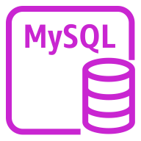
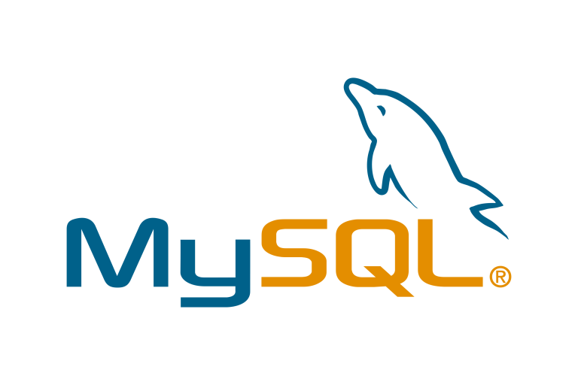




Overall Architecture
Aurora MySQL Cluster
EKS Cluster
Query & Scrap Metrics
Discover & Scrap
Metrics
Write Metrics
(Prometheus
Remote Write)
Aurora MySQL One
/ Writer
MySQLd Exporter
/ Writer
Request
Dashboards
ADOT
Collector
Query Metrics
Aurora MySQL Two
/ Reader
MySQLd Exporter
/ Reader
AMP
AMG
Client
ADOT
Collector
Aurora MySQL Three
/ Reader
MySQLd Exporter
/ Reader
Notes:
AWS Device Farm is an app testing service that lets you test and interact with your Android, iOS, and web apps on many devices at once, or reproduce issues on a device in real time. View video, screenshots, logs, and performance data to pinpoint and fix issues and increase quality on real consumer devices, the same devices that your users are facing, before shipping your app. Device Farm solves two major testing formats – Manual Testing of applications, and Automated testing of your application on multiple devices simultaneously, all on the same real devices that your users use.

Slide 5
Amazon EKS
관리형 Kubernetes Service
Kubernetes Control Plane 관리 기능 제공
Kubernetes Version Upgrade 기능 제공
Upstream Kubernetes 환경 제공
높은 호환성 보장
대부분의 Kubernetes 기반의 Tool 이용 가능
Amazon EKS
→ MySQLd Exporter, ADOT Collector 구동

Slide 6
ADOT (AWS Distro for OpenTelemetry) Collector
Log, Metric, Trace 수집 가능
Prometheus Receiver 지원
Prometheus Remote Write Exporter 지원
고가용성을 위해서 2개의 Pod 구동
ADOT Collector
→ MySQLd Exporter의 Metric을 AMP에 전달
Notes:
AWS Device Farm is an app testing service that lets you test and interact with your Android, iOS, and web apps on many devices at once, or reproduce issues on a device in real time. View video, screenshots, logs, and performance data to pinpoint and fix issues and increase quality on real consumer devices, the same devices that your users are facing, before shipping your app. Device Farm solves two major testing formats – Manual Testing of applications, and Automated testing of your application on multiple devices simultaneously, all on the same real devices that your users use.

Slide 7
ADOT Collector / Pipeline
ADOT Collector
Extension
Health Check
AWS SigV4Auth
Source
MySQLd Exporter
/ Writer
Destination
Pipeline
Receiver
Processor
Exporter
Prometheus
Prometheus
Remote Write
MySQLd Exporter
/ Reader
AMP
MySQLd Exporter
/ Reader

Slide 8
ADOT Collector / Config
receivers:
prometheus:
config:
global:
scrape_interval: 30s
scrape_timeout: 10s
scrape_configs:
- job_name: kubernetes-pods
kubernetes_sd_configs:
- role: pod
relabel_configs:
- action: keep
regex: true
source_labels:
- __meta_kubernetes_pod_annotation_prometheus_io_scrape
- action: replace
regex: (https?)
source_labels:
- __meta_kubernetes_pod_annotation_prometheus_io_scheme
target_label: __scheme__
- action: replace
regex: (.+)
source_labels:
- __meta_kubernetes_pod_annotation_prometheus_io_path
target_label: __metrics_path__
- action: replace
regex: ([^:]+)(?::\d+)?;(\d+)
replacement: $$1:$$2
source_labels:
- __address__
- __meta_kubernetes_pod_annotation_prometheus_io_port
target_label: __address__
- action: labelmap
regex: __meta_kubernetes_pod_annotation_prometheus_io_param_(.+)
replacement: __param_$$1
- action: labelmap
regex: __meta_kubernetes_pod_label_(.+)
- action: replace
source_labels:
- __meta_kubernetes_namespace
target_label: kubernetes_namespace
- action: replace
source_labels:
- __meta_kubernetes_pod_name
target_label: kubernetes_pod_name
- action: drop
regex: Pending|Succeeded|Failed|Completed
source_labels:
- __meta_kubernetes_pod_phase
Pipeline, Extension 설정
apiVersion: v1
kind: Pod
metadata:
annotations:
prometheus.io/path: /metrics
prometheus.io/port: "9104"
prometheus.io/scrape: "true”
...
Discover & Scrap
Metrics
ADOT Collector ConfigMap
exporters:
prometheusremotewrite:
endpoint: ${amp_remote_write_endpoint}
auth:
authenticator: sigv4auth
extensions:
health_check:
sigv4auth:
region: ${region}
service:
extensions: [health_check, sigv4auth]
pipelines:
metrics:
receivers: [prometheus]
exporters: [prometheusremotewrite]

Slide 9
ADOT Collector / IRSA
{
"Statement": [
{
"Action": [
"aps:RemoteWrite",
"aps:QueryMetrics",
"aps:GetSeries",
"aps:GetMetricMetadata",
"aps:GetLabels"
],
"Effect": "Allow",
"Resource": "*"
}
],
"Version": "2012-10-17"
}
ADOT Collector에게 IRSA (IAM Roles for Service Accounts)를 통해서 AMP 권한 부여
apiVersion: v1
kind: ServiceAccount
metadata:
name: adot-collector
annotations:
eks.amazonaws.com/role-arn: arn:aws:iam::xxxxxxxxxxxx:role/eks-db-monitoring-irsa-adot-collector
eks-db-monitoring-irsa-adot-collector Role Policy
ADOT Collector Service Account
{
"Version": "2012-10-17",
"Statement": [
{
"Effect": "Allow",
"Principal": {
"Federated": "arn:aws:iam::xxxxxxxxxxxx:oidc-provider/oidc.eks.ap-northeast-2.amazonaws.com/id/xxxxxxxxxxxxxxxxxxxxxxxxxxxxxxxx"
},
"Action": "sts:AssumeRoleWithWebIdentity",
"Condition": {
"StringEquals": {
"oidc.eks.ap-northeast-2.amazonaws.com/id/21750190EB5A357C8EAE19A37D8C06E6:sub": "system:serviceaccount:observability:adot-collector",
"oidc.eks.ap-northeast-2.amazonaws.com/id/21750190EB5A357C8EAE19A37D8C06E6:aud": "sts.amazonaws.com"
}
}
}
]
}
eks-db-monitoring-irsa-adot-collector Trust Relationship

Slide 10
MySQLd Exporter
MySQL에 Query 수행을 통해서 Metric 수집
수집한 Metric을 Prometheus Exporter 형태로 노출
MySQLd Instance와 1:1로 구성
MySQLd Exporter
→ Aurora MySQL Server의 Metric을 Prometheus Exporter 형태로 노출
Notes:
AWS Device Farm is an app testing service that lets you test and interact with your Android, iOS, and web apps on many devices at once, or reproduce issues on a device in real time. View video, screenshots, logs, and performance data to pinpoint and fix issues and increase quality on real consumer devices, the same devices that your users are facing, before shipping your app. Device Farm solves two major testing formats – Manual Testing of applications, and Automated testing of your application on multiple devices simultaneously, all on the same real devices that your users use.

Slide 11
MySQLd Exporter / Install Helm Chart
$ helm repo add prometheus-community https://prometheus-community.github.io/helm-charts
$ helm repo update
$ helm install [cluster name]-one prometheus-community/prometheus-mysql-exporter
$ helm install [cluster name]-two prometheus-community/prometheus-mysql-exporter
$ helm install [cluster name]-three prometheus-community/prometheus-mysql-exporter
Aurora MySQL Cluster
EKS Cluster
Query & Scrap Metrics
apiVersion: v1
kind: Pod
metadata:
annotations:
prometheus.io/path: /metrics
prometheus.io/port: "9104"
prometheus.io/scrape: "true”
labels:
app.kubernetes.io/instance: [cluster name]-one
app.kubernetes.io/name: prometheus-mysql-exporter
...
Aurora MySQL One
/ Writer
MySQLd Exporter
/ Writer
apiVersion: v1
kind: Pod
metadata:
annotations:
prometheus.io/path: /metrics
prometheus.io/port: "9104"
prometheus.io/scrape: "true”
labels:
app.kubernetes.io/instance: [cluster name]-two
app.kubernetes.io/name: prometheus-mysql-exporter
...
Aurora MySQL Two
/ Reader
MySQLd Exporter
/ Reader
apiVersion: v1
kind: Pod
metadata:
annotations:
prometheus.io/path: /metrics
prometheus.io/port: "9104"
prometheus.io/scrape: "true”
labels:
app.kubernetes.io/instance: [cluster name]-three
app.kubernetes.io/name: prometheus-mysql-exporter
...
Aurora MySQL Three
/ Reader
MySQLd Exporter
/ Reader
Notes:
AWS Device Farm is an app testing service that lets you test and interact with your Android, iOS, and web apps on many devices at once, or reproduce issues on a device in real time. View video, screenshots, logs, and performance data to pinpoint and fix issues and increase quality on real consumer devices, the same devices that your users are facing, before shipping your app. Device Farm solves two major testing formats – Manual Testing of applications, and Automated testing of your application on multiple devices simultaneously, all on the same real devices that your users use.

Slide 12
AMP (AWS Managed Service for Prometheus)
AWS 관리형 Prometheus
Prometheus Remote Write Protocol을 통해서 Metric 수신
AMP
→ ADOT Collector로부터 MySQLd Exporter Metric 수신 및 저장
Notes:
AWS Device Farm is an app testing service that lets you test and interact with your Android, iOS, and web apps on many devices at once, or reproduce issues on a device in real time. View video, screenshots, logs, and performance data to pinpoint and fix issues and increase quality on real consumer devices, the same devices that your users are facing, before shipping your app. Device Farm solves two major testing formats – Manual Testing of applications, and Automated testing of your application on multiple devices simultaneously, all on the same real devices that your users use.

Slide 13
AMG (AWS Managed Service for Grafana)
AWS 관리형 Grafana
AMP, CloudWatch Metric 시각화 가능
AMG
→ AMP에 저장된 Metric Query 및 시각화
Notes:
AWS Device Farm is an app testing service that lets you test and interact with your Android, iOS, and web apps on many devices at once, or reproduce issues on a device in real time. View video, screenshots, logs, and performance data to pinpoint and fix issues and increase quality on real consumer devices, the same devices that your users are facing, before shipping your app. Device Farm solves two major testing formats – Manual Testing of applications, and Automated testing of your application on multiple devices simultaneously, all on the same real devices that your users use.

Slide 14
Metric 살펴보기
mysql_global_status_auroradb_commit_latency{app_kubernetes_io_instance=”[cluster-name]-one",app_kubernetes_io_name="prometheus-mysql-exporter",instance="10.0.72.205:9104",job="kubernetes-pods",kubernetes_namespace=”default",kubernetes_pod_name="aurora-mysql-two-prometheus-mysql-exporter-68d5bdc476-kzdz8",pod_template_hash="68d5bdc476"} 4774091542
app_kubernetes_io_instance : Helm Install Name
instance : MySQLd Exporter Pod IP
Notes:
AWS Device Farm is an app testing service that lets you test and interact with your Android, iOS, and web apps on many devices at once, or reproduce issues on a device in real time. View video, screenshots, logs, and performance data to pinpoint and fix issues and increase quality on real consumer devices, the same devices that your users are facing, before shipping your app. Device Farm solves two major testing formats – Manual Testing of applications, and Automated testing of your application on multiple devices simultaneously, all on the same real devices that your users use.

Slide 15
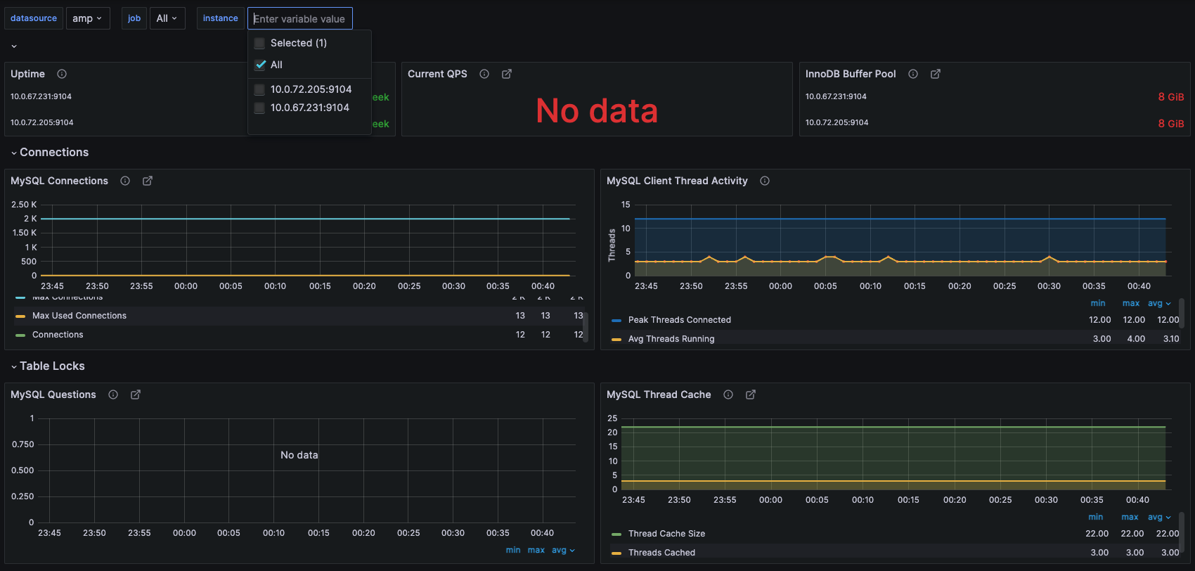
MySQL Dashboard
https://grafana.com/grafana/dashboards/14057-mysql/
Notes:
AWS Device Farm is an app testing service that lets you test and interact with your Android, iOS, and web apps on many devices at once, or reproduce issues on a device in real time. View video, screenshots, logs, and performance data to pinpoint and fix issues and increase quality on real consumer devices, the same devices that your users are facing, before shipping your app. Device Farm solves two major testing formats – Manual Testing of applications, and Automated testing of your application on multiple devices simultaneously, all on the same real devices that your users use.

Slide 16
고도화 해보기

Slide 17
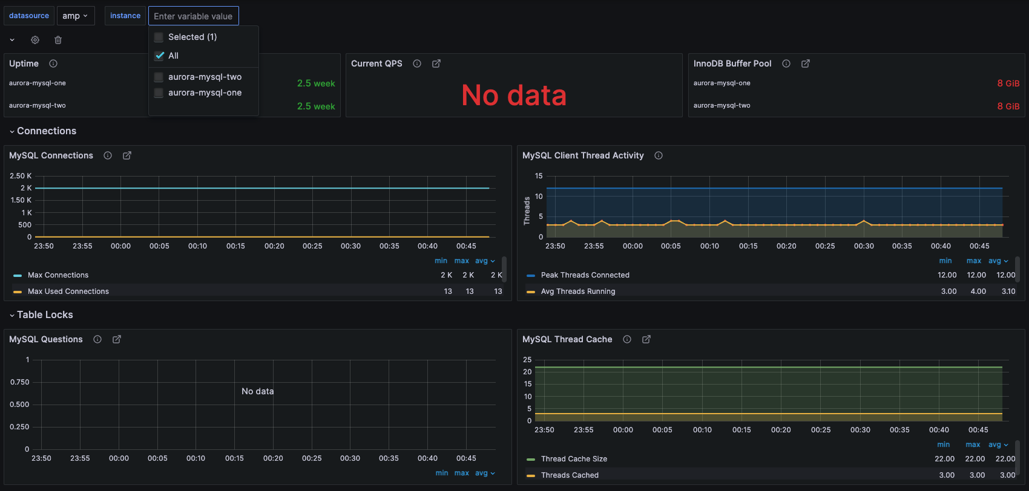
MySQL Dashboard (filter by Helm Install Name)
Notes:
AWS Device Farm is an app testing service that lets you test and interact with your Android, iOS, and web apps on many devices at once, or reproduce issues on a device in real time. View video, screenshots, logs, and performance data to pinpoint and fix issues and increase quality on real consumer devices, the same devices that your users are facing, before shipping your app. Device Farm solves two major testing formats – Manual Testing of applications, and Automated testing of your application on multiple devices simultaneously, all on the same real devices that your users use.

Slide 18

AMP Metric, CloudWatch Metric 동시에 시각화
Scrap Metrics
Query Metrics
Aurora MySQL Cluster
EKS Cluster
Query & Scrap Metrics
Discover & Scrap
Metrics
CloudWatch
Write Metrics
(Prometheus
Remote Write)
Aurora MySQL One
/ Writer
MySQLd Exporter
/ Writer
Request
Dashboards
ADOT
Collector
Query Metrics
Aurora MySQL Two
/ Reader
MySQLd Exporter
/ Reader
AMP
AMG
Client
ADOT
Collector
Aurora MySQL Three
/ Reader
MySQLd Exporter
/ Reader
Notes:
AWS Device Farm is an app testing service that lets you test and interact with your Android, iOS, and web apps on many devices at once, or reproduce issues on a device in real time. View video, screenshots, logs, and performance data to pinpoint and fix issues and increase quality on real consumer devices, the same devices that your users are facing, before shipping your app. Device Farm solves two major testing formats – Manual Testing of applications, and Automated testing of your application on multiple devices simultaneously, all on the same real devices that your users use.

Slide 19
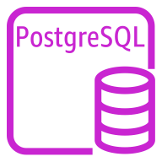

Postgres Exporter
$ helm repo add prometheus-community https://prometheus-community.github.io/helm-charts
$ helm repo update
$ helm install [cluster name]-one prometheus-community/prometheus-postgres-exporter
$ helm install [cluster name]-two prometheus-community/prometheus-postgres-exporter
$ helm install [cluster name]-three prometheus-community/prometheus-postgres-exporter
Aurora Postgres
Cluster
EKS Cluster
Query & Scrap Metrics
apiVersion: v1
kind: Pod
metadata:
annotations:
prometheus.io/path: /metrics
prometheus.io/port: "9104"
prometheus.io/scrape: "true”
labels:
app.kubernetes.io/instance: [cluster name]-one
app.kubernetes.io/name: prometheus-postgres-exporter
...
Aurora MySQL One
/ Writer
Postgres Exporter
/ Writer
apiVersion: v1
kind: Pod
metadata:
annotations:
prometheus.io/path: /metrics
prometheus.io/port: "9104"
prometheus.io/scrape: "true”
labels:
app.kubernetes.io/instance: [cluster name]-two
app.kubernetes.io/name: prometheus-postgres-exporter
...
Aurora MySQL Two
/ Reader
Postgres Exporter
/ Reader
apiVersion: v1
kind: Pod
metadata:
annotations:
prometheus.io/path: /metrics
prometheus.io/port: "9104"
prometheus.io/scrape: "true”
labels:
app.kubernetes.io/instance: [cluster name]-three
app.kubernetes.io/name: prometheus-postgres-exporter
...
Aurora MySQL Three
/ Reader
Postgres Exporter
/ Reader
Notes:
AWS Device Farm is an app testing service that lets you test and interact with your Android, iOS, and web apps on many devices at once, or reproduce issues on a device in real time. View video, screenshots, logs, and performance data to pinpoint and fix issues and increase quality on real consumer devices, the same devices that your users are facing, before shipping your app. Device Farm solves two major testing formats – Manual Testing of applications, and Automated testing of your application on multiple devices simultaneously, all on the same real devices that your users use.

Slide 20
Demo

Slide 21

DEMO Architecture
Aurora MySQL Cluster
EKS Cluster
Query & Scrap Metrics
Discover & Scrap
Metrics
Aurora MySQL One
/ Writer
MySQLd Exporter
/ Writer
Write Metrics
(Prometheus
Remote Write)
Aurora MySQL Two
/ Reader
MySQLd Exporter
/ Reader
ADOT
Collector
Aurora Postgres
Cluster
AMP
Postgres Exporter
/ Writer
ADOT
Collector
Query Metrics
Aurora MySQL One
/ Writer
Request
Dashboards
Postgres Exporter
/ Reader
Aurora MySQL Two
/ Reader
Grafana
Client
Notes:
AWS Device Farm is an app testing service that lets you test and interact with your Android, iOS, and web apps on many devices at once, or reproduce issues on a device in real time. View video, screenshots, logs, and performance data to pinpoint and fix issues and increase quality on real consumer devices, the same devices that your users are facing, before shipping your app. Device Farm solves two major testing formats – Manual Testing of applications, and Automated testing of your application on multiple devices simultaneously, all on the same real devices that your users use.

